Slide 1

Mini Project (KCA353) Odd Semester Session 2024-25
Yashodhan Tyagi (23002901401211)
Shobhit Chauhan (2300290140176)
Project Supervisor : Mr. Ritesh Kumar Gupta

Slide 2
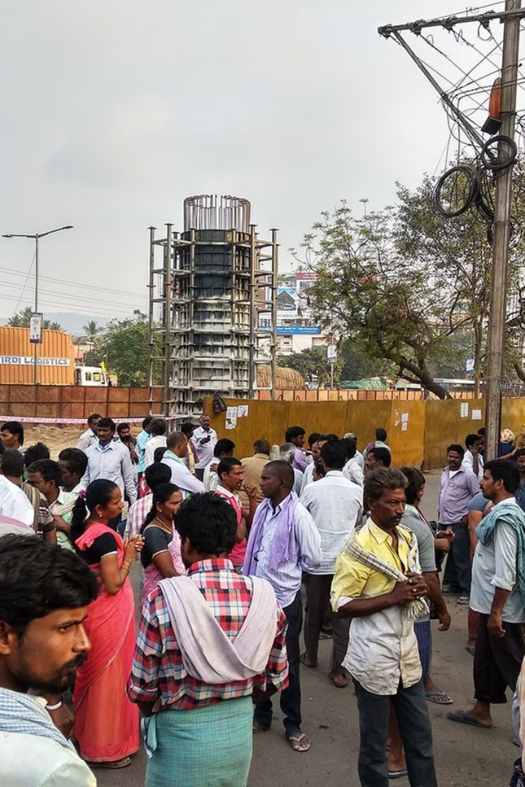
Introduction
Daily wage workers face numerous challenges due to uncertainties in income, lack of job security, and limited access to resources and opportunities. Given the significant impact of these challenges, there is a need for innovative solutions catering specifically to this demographic. This presentation will introduce a website idea designed to address the unique needs and challenges faced by daily wage workers.

Slide 3
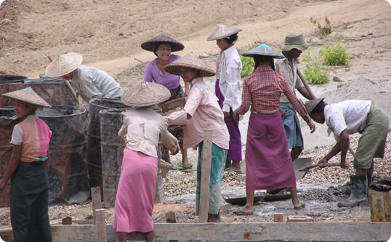
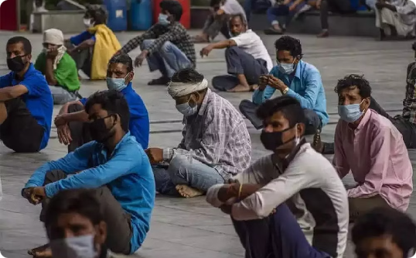
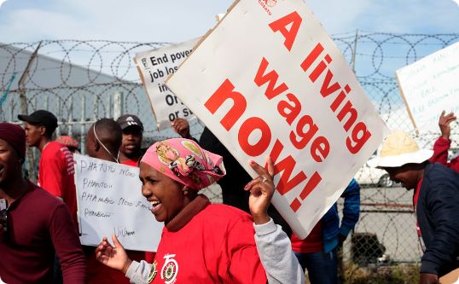
Problem Statement: Challenges Faced by Daily Wages Workers
Lack of Job Security
Difficulties they face
Income Uncertainties
Many daily wage workers do not have guaranteed employment, leading to financial insecurities and the inability to plan for the future.
They have to stand in cold weather ,hot weather and in rain also. Which is also not good for their health .
The irregular and unpredictable nature of income makes it challenging for daily wage workers to meet their basic needs and plan for emergencies.

Slide 4
Solution: workboat
1
Employment Opportunities
It will feature a section dedicated to connecting daily wage workers with job opportunities and short-term employment options, empowering them to secure consistent work.
2
Improve Health
It improve their health also because now, they are not need to wait for work in bad weather.
3
Better income
Now, there is no irregularities and unpredictable nature of income . which help them to save money for their future.

Slide 5

Features of the Website
Provide work
Job Listings
We create an section where anyone who need workers, just post an request which will shown to workers ,if they are interested in that work they just confirm it and they got work .
Regularly updated job listings from various industries and sectors, specifically targeting daily wage workers looking for employment opportunities.

Slide 6

Benefits for Daily Wages Workers
1
Improved Livelihood
2
Financial Stability
The website will enable access to better job opportunities to increased standard of living for daily wage workers.
Access to reliable employment options and financial resources will contribute to greater financial stability and independence.

Slide 7

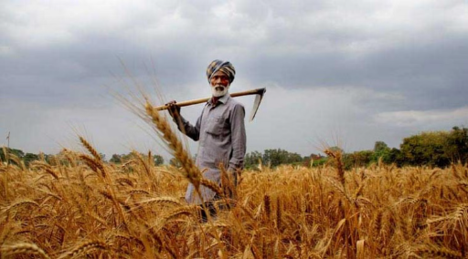
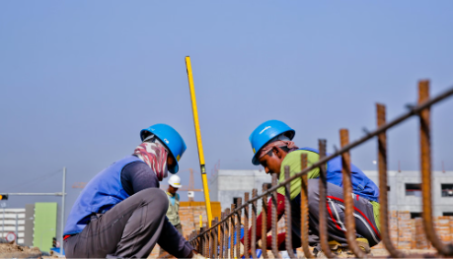
Target Audience
Construction Workers
Retail and Service Staff
Agricultural Laborers
This website is designed to cater to the needs of construction workers, providing them with job opportunities, training, and support services.
Workers in retail and service industries can benefit from the job listings and educational resources offered on the website.
The website will provide support and information for agricultural laborers seeking improved livelihoods and access to resources.

Slide 8


Hardware Requirements
Development Environment
Intel Core i3, 4GB RAM, 1TB HDD
Server Requirement
High Availability Cloud Servers
Client Requirement
Any device with internet access and a web browser

Slide 9

Technology Used

Slide 10





Modules
User Registration/Login
Secure account creation and access.
Job Listing
Browse and find available Jobs.
Interactive Map Integration
Locate Job on a map.
Secure Payments and Transaction System
Safe and reliable payment processing.
Admin Panel for Moderation
Manage platform content and users.

Slide 11
Workflow
User Registers/Logs in
1
Create or access an account.
2
User Browses Listings
Find Labours to hire.
Payments Processed
3
Securely complete transactions.
4
Return Process and Feedback
Complete the rental cycle and provide feedback.

Slide 12
Conclusion
In conclusion, the website idea for daily wage workers aims to bridge the gap between challenges and opportunities, offering a solution-oriented platform that prioritizes empowerment, education, and financial stability. By addressing the specific needs of this demographic and leveraging innovative strategies, the website has the potential to make a meaningful impact on the lives of daily wage workers across various sectors and industries.

